Slide 1
Dynamic Systems Development Method Practices

Slide 2
Outline
Overview
Pre - project Phase
Feasibility Phase
Foundation Phase
Evolutionary Development Phase
Deployment Phase
Post - project Phase
The Lifecycle in practice
Configuring DSDM for Scalability and Formality

Slide 3
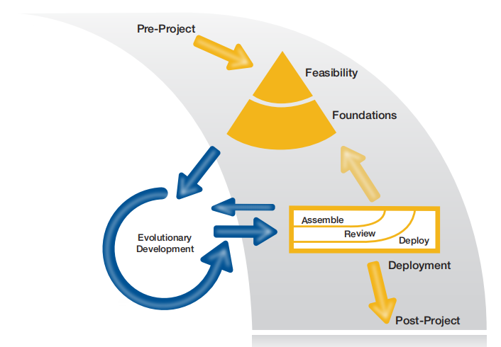
Overview : The DSDM Process
Process is used to create lifecycle for each project
Each phase has defined objectives
Focus of Agile Project Manager varies from phase to phase

Slide 4
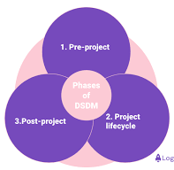
Overview : Planning in a DSDM Project
Strategic planning starts in Feasibility
- Initial outline of project management and solution development approaches
- Supported by possible timeline for delivery
This information gradually refined during Foundations
- Generates high-level plans and agreed ways of working
- Forms basis of commitment to deliver what business needs when business needs it

Slide 5
Overview : Planning in a DSDM Project
Plans always need to evolve to meet changes in real-world circumstances
- As business needs shift
- As requirements and solution detail emerges
- As understanding of what is possible and what is necessary changes
Agile PM not responsible for all planning activity
Key Agile PM responsibility to ensure all plans align with high-level plans to deliver what business needs, at time agreed, within agreed costs

Slide 6
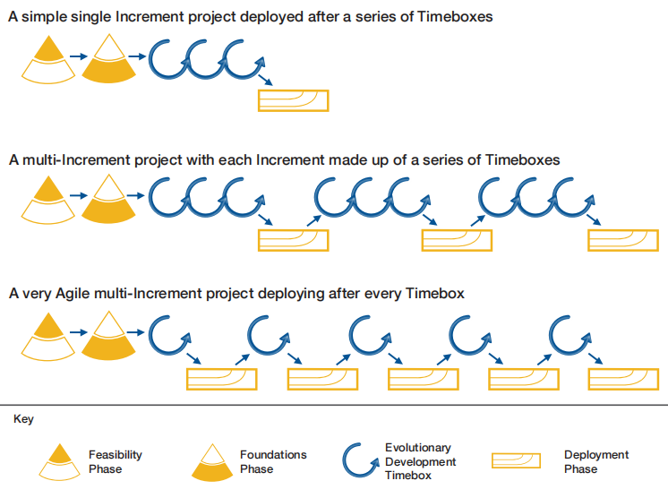
Configuring the Process - 3 lifecycle examples
Solution built and deployed incrementally from a firm foundation
Ensure value delivered early and delivered frequently

Slide 7
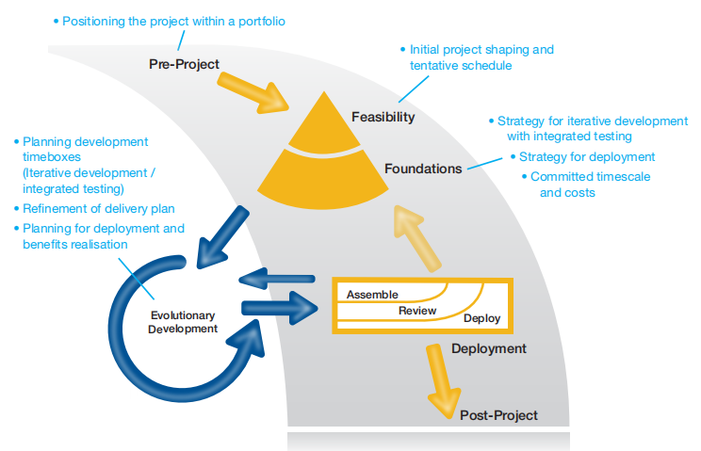
Planning Activity Phase by Phase

Slide 8
Pre-Project Phase
Pre-Project
- Ensure only the right projects are started
- Ensure projects are set up correctly based on clearly defined objective
Keep Pre-Project short and sharp
Main purpose is to position project and justify Feasibility
Formality varies, depending on organisation
There is no PM involvement Pre-Project

Slide 9
Pre-Project Phase (cont.)
Planning at Pre-Project
- Working at programme / portfolio level
- Focused on whether and when Feasibility will be assessed
- Ensuring Feasibility resources are available to do required work
- Planning for detail of next phase (Feasibility)
Pre-Project

Slide 10
Feasibility Phase
PM works with Project-level roles including Business Analyst PM may also include
- Advisors (Business and Technical)
- As many SDT members as possible
Focus is to establish whether proposed project
- Is likely to be feasible
• Both from business and technical perspective
- Would be cost-effective
• From business perspective

Slide 11
Feasibility Phase (cont.)
To plan and resource Foundations phase
- The six key Foundation products created in outline here
Feasibility effort - just enough to decide whether further investigation is justified or project should be stopped if unlikely to be viable

Slide 12

Feasibility Phase (cont.)
Planning during Feasibility
- Based on outline information (requirements and solution)
- Planning for detail of next phase (Foundations)
- Providing an approximation of size and duration of overall project
• Based on what is known at this point - an educated guess
- Delivery Plan describes
• Next few weeks in detail (Foundations)
• High-level outline for first Increment
• Possibly list of proposed dates for Increments into the future
- Plan includes timescale, deliverables, resources and facilities needed
- Not yet possible to plan any detail for Evolutionary Development or Deployment
Pre-Project
Feasibility

Slide 13
Foundations Phase
PM works with Project-level roles, including Business Analyst and involving:
- Business and Technical Advisors
- As many SDT members as possible
Organising work to establish firm Foundations
- From Business perspective
• Agreed realistic Business Case (Recommended)
• Prioritised Requirements List (Mandatory)

Slide 14
Foundations Phase (cont.)
From Solution / Technical perspective
• Solution Architecture Definition and Development Approach Definition
- From Management perspective
• Delivery Plan (Mandatory)
• Management Approach Definition
• Foundations Summary
PM establishes which of 6 key Foundations products need to be created or evolved from Feasibility outline set

Slide 15

Foundations Phase (cont.)
Based on
- More detailed understanding of requirements and priorities
- Reduced uncertainty and increased accuracy of estimates
Focus is on
- Creating schedule of Timeboxes for first Increment, with resources needed
- Defining approaches to be used for developing and controlling development of solution
- Agreeing strategy for Deployment and assessing high-level impact of change and training needs
• Delivery Plan baselined at end of Foundations
• Delivery date for first Increment is committed
Delivery Plan also provides
- Probable focus for each Timebox in this Increment
- Resources required to evolve solution
Delivery Plan does not include detailed Timebox objectives and tasks
Foundations

Slide 16
Evolutionary Development Phase
Evolutionary Development builds on project firm foundations to evolve the solution
- Through use of DSDM Practices
- Converging on accurate solution that meets business need and technically is built the right way
PM passes day-to-day management of Timeboxes to SDT
- PM focuses mainly on ensuring project environment optimised for agile development
- Protecting ST from distractions
- Ensuring tools and facilities available as planned

Slide 17
Evolutionary Development Phase (cont.)
During Evolutionary Development, PM
- Participates in (and may facilitate) Timebox Kick-off
- Participates in Timebox Close-out
• To measure progress, to feed learning and
incomplete work back into Delivery Plan
- Ensures people and resources are committed for duration of Timebox
- Manages engagement of Business Ambassadors, Advisors
and any part-time resources
- "Manages by exception"
PM works primarily with Visionary and Technical Coordinator to plan Deployment

Slide 18
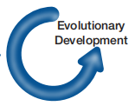
Evolutionary Development Phase (cont.)
Timebox planning at beginning of each Timebox
- This is lowest level of DSDM Planning
- SDT members responsible for Timebox planning
Timebox Plans based on
- Objectives and outcomes plus Timebox length agreed at Timebox Kick-off
- Task-level estimates that emerge as result of detailed investigation of requirements
- Decisions made on how requirements will be fulfilled

Slide 19
Evolutionary Development Phase (cont.)
Timebox Plans
- Typically captured on Team Board (or electronically)
- Indicate who will do what work to achieve Timebox objectives and generate agreed outcome
Team Leader ensures
- All work is covered by the plan
- Resources are sufficient to do majority of work agreed
- Flagging any significant issues that may arise as TB progresses

Slide 20
Deployment Phase
Deployment
To bring a baseline of Evolving Solution into operational use
- This may be the final solution or a subset of final solution
After last release, Project is formally closed
Project Manager
Coordinates day-to-day activities to bring Solution Increment into live operational use
Ensures everything is coherent and right people are involved
- Business Visionary (responsible for business change)
- Technical Coordinator (responsible for technical transition into live use)
- Collaborating with ST and other stakeholders
Organises Increment Retrospective
- Results captured in Project Review Report

Slide 21

Deployment Phase (cont.)
Planning for Deployment
- As detail emerges during Evolutionary Development, plans for Deployment can be considered in more detail
- Deployment involves everything needed to transition solution into live use
- Delivery Plan is updated with Deployment activities as they become clear
- Plans for Deployment should always include roll-back options

Slide 22
Post-Project Phase
Post-Project
To check how well expected business benefits have been met
There is no PM involvement here as the project has been closed down by this point
Planning benefits assessment activity, Post-Project
- Based on clearer Deployment plans

Slide 23
Post-Project Phase (cont.)
• Activities needed Post-Project to measure benefits can now be planned
• Activity for this owned by Business Visionary, who owns wider implications change
Incremental nature of DSDM means revisiting Foundations at end of each Increment helps :
- Check project as whole remains viable and should proceed to next Increment
• Based on validated actual effort and updated more informed view of Business Case
- Firm up plans for the subsequent Increment
Post-Project

Slide 24
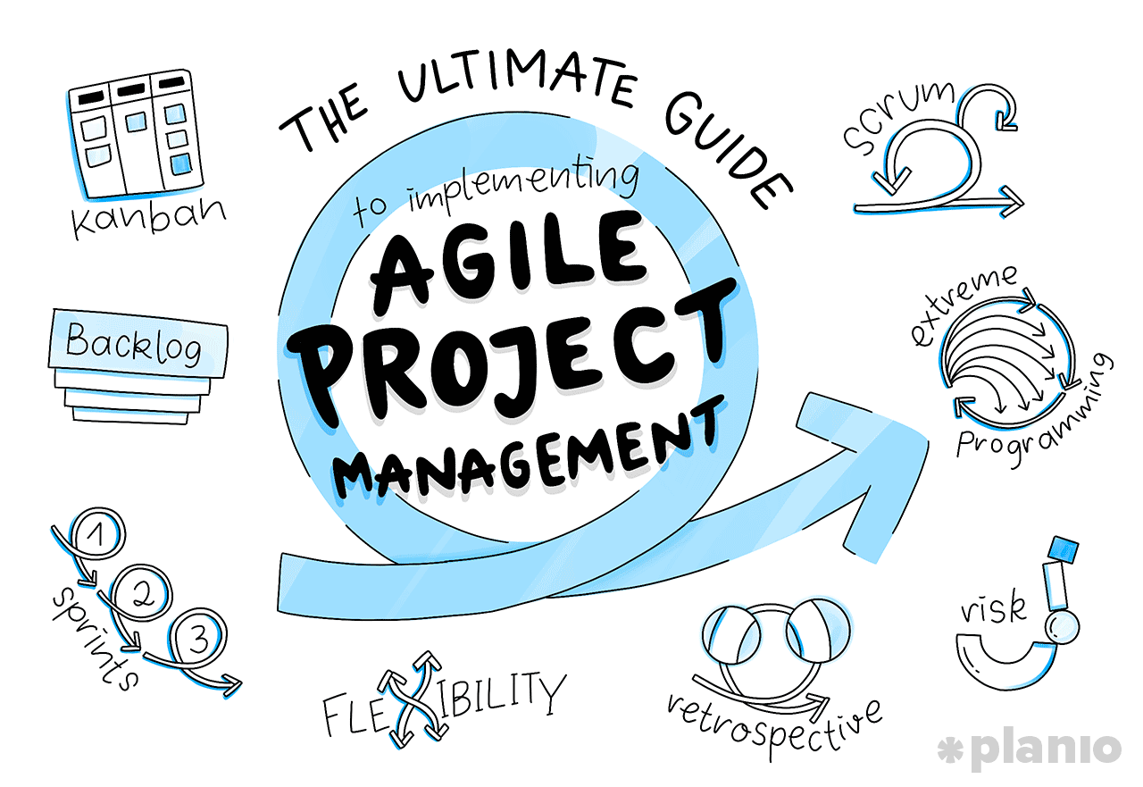
Planning - Agile PM Top Tips
Remember DSDM planning activities are always highly collaborative.
- Collaboration brings in expertise of those executing the plans
- Collaboration improves buy-in to the plans
• This is especially important for Delivery Plan
Timebox Planning is not your responsibility - it is owned by SDT
- You only need to review Timebox Plan
• To ensure it aligns with agreed TB objectives and that it remains aligned
Any tools supporting planning activity should not work against or constrain effective DSDM planning
When planning, always check to ensure work identified adds real value to the project

Slide 25

Configuring DSDM for Scalability and Formality
DSDM recognises the value of Agility:
Improves project productivity.
Enhances solution quality.
Accepts constraints in corporate environments.
Common corporate constraints:
Financial governance.
Architecture and/or infrastructure strategies.
Regulatory governance.
Vendor agreements.
Third-party support considerations.

Slide 26
Configuring DSDM for Scalability and Formality
Configurability of the DSDM process:
Can be tailored for different project sizes.
Small projects → lighter governance.
Large projects → stronger governance.
Lifecycle configured to suit the project.
Formality of DSDM products defined, created, and approved at appropriate levels.
Scaling project organisation:
Structure can be refined to support multiple teams.
Key roles act as directors and coordinators across teams.
For complex projects, products can be made more detailed and formal:
  Solution Architecture Definition.
  Development Approach Definition.
  Management Approach Definition.
  Delivery Plan and Timebox Review Records.

Slide 27

Questions on Project Planning Through the Lifecycle?

Slide 28
EXERCISES
What is the purpose of the DSDM Pre-Project phase?
a) Ensures that only the right projects are started and set up correctly
b) Assesses the viability of the project
c) Ensures the project can be carried out by the Solution Development Team
d) Plans and resources the Foundations phase
What is a purpose of the Feasibility phase?
a) Converge over time on an accurate solution that meets a business need
b) Establish whether or not the project should be stopped
c) Establish how development and delivery of the solution will be managed
d) Bring a baseline of the solution into operational use

Slide 29
EXERCISES
3. Which purpose relates to the Foundations phase?
a) Converge over time on an accurate solution that meets a business need
b) Check how well the expected business benefits have been met
c) Establish how development and delivery of the solution will be managed
d) Bring a baseline of the solution into operational use
4. What is the purpose of the Evolutionary Development phase?
a) Converge over time on an accurate solution that meets a business need
b) Establish whether the project appears cost-effective
c) Establish how development and delivery of the solution will be managed
d) Bring a baseline of the solution into operational use

Slide 30
EXERCISES
5. When, ideally, is the first instance that a solution should be fully tested and potentially deployable?
a) At the Review stage of Deployment
b) At the end of a Timebox
c) On Deployment
d) After Deployment
6. When does DSDM state that the Post-Project phase takes place?
a) After Evolutionary Development
b) Before the project is closed
c) When the solution is assembled
d) After the final Deployment for a project

Slide 31
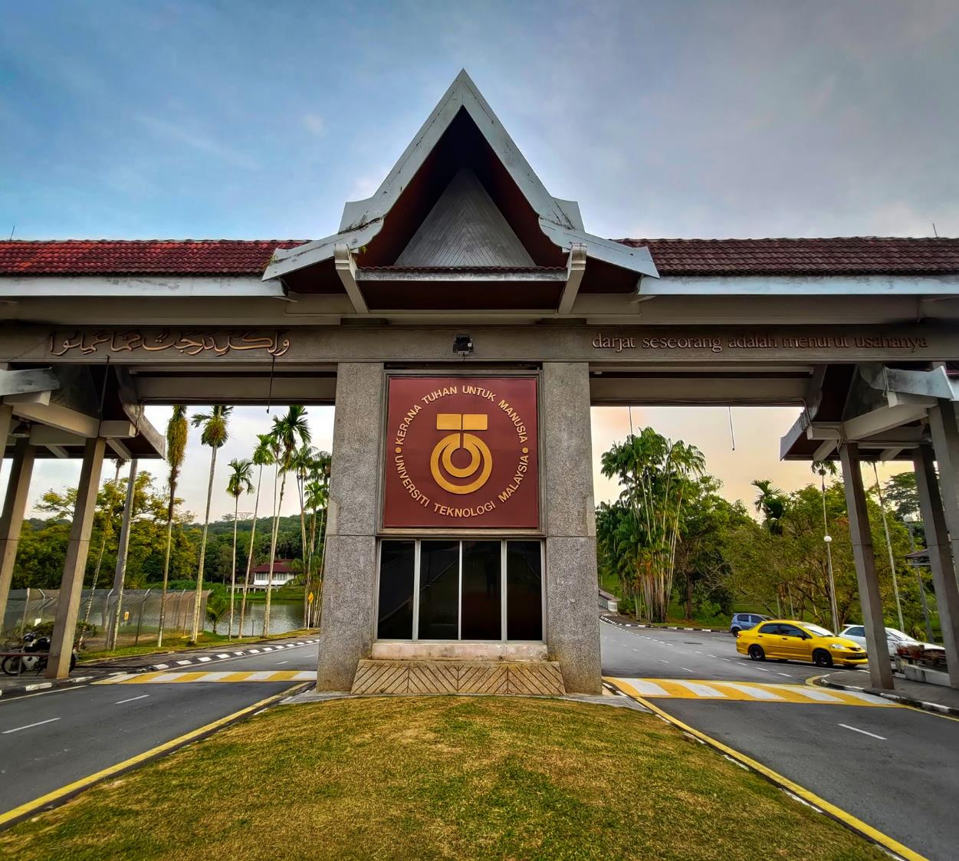






THANK YOU
In the Name of God for Mankind
www.utm.my

